Slide 1
Neural Networks
Presented By
Mhd Sami AlEsh & Mhd Alaa Khair Allah

Slide 2
Key notes
01
Introduction
02
How Neural Networks Works ?
03
Neural Network Applications
04
Neural Network Problems

Slide 3
What is Neural Networks ?
1
It is an interconnected web of nodes ,which are called neurons ,and the edges that join them together.
2
A Neural Network main function is to receive a set of inputs perform progressively complex calculations , and then use the output to solve the problem.
3
It has so many types most common are : RNN and CNN
4
It is mainly used for : Classification , Prediction and Clustering .

Slide 4
Neural Network Structure

Slide 5
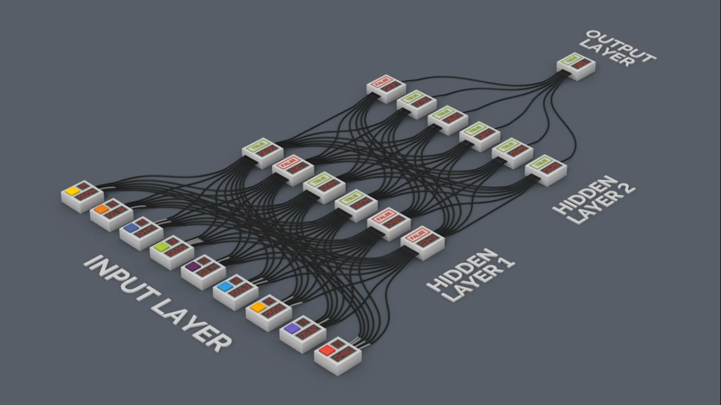
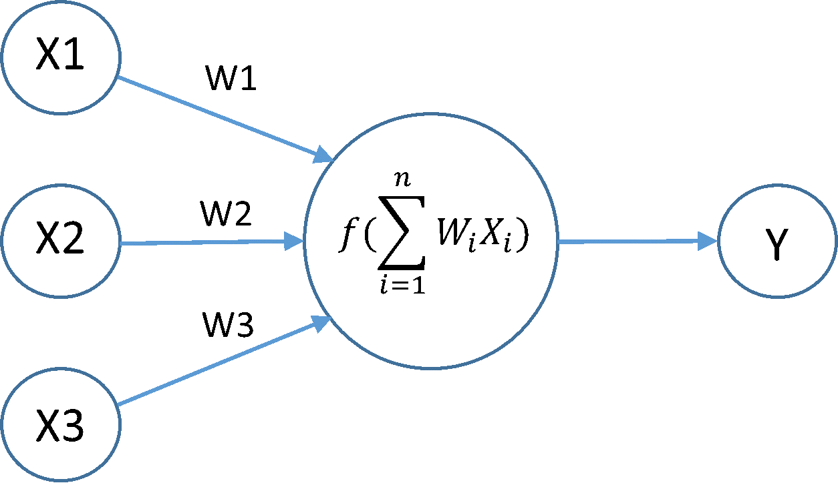
NN LAYERS AND COMPONENTS

Slide 6

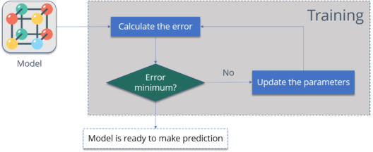
EX: CAT RECOGNITION

Slide 7
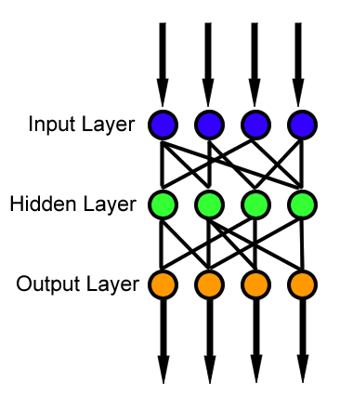
FORWARD PROP

Slide 8
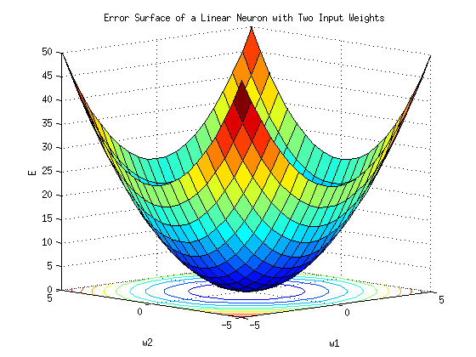
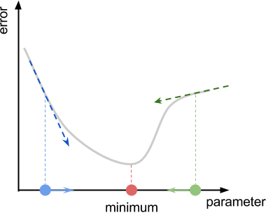
BACKWARD PROP

Slide 9
Neural Network Applications

Slide 10


1
Machine Translation
sometimes referred to by the abbreviation MT is a sub-field of computational linguistics that investigates the use of software to translate text or speech from one language to another.
Hello

Slide 11

2
Robot control
Study and practice of controlling robots.

Slide 12
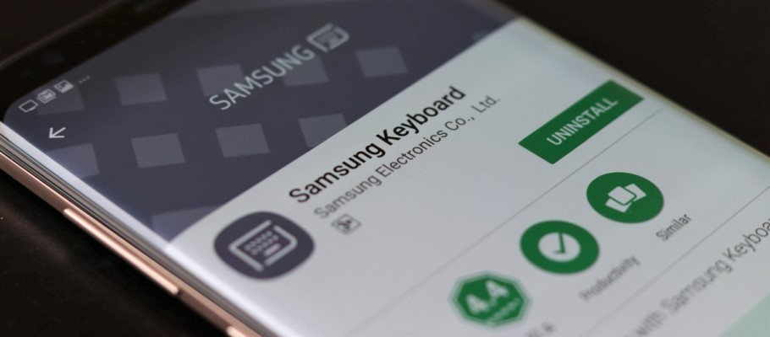

3
Speech recognition
develops methodologies and technologies that enables the recognition and translation of spoken language into text by computers.

Slide 13
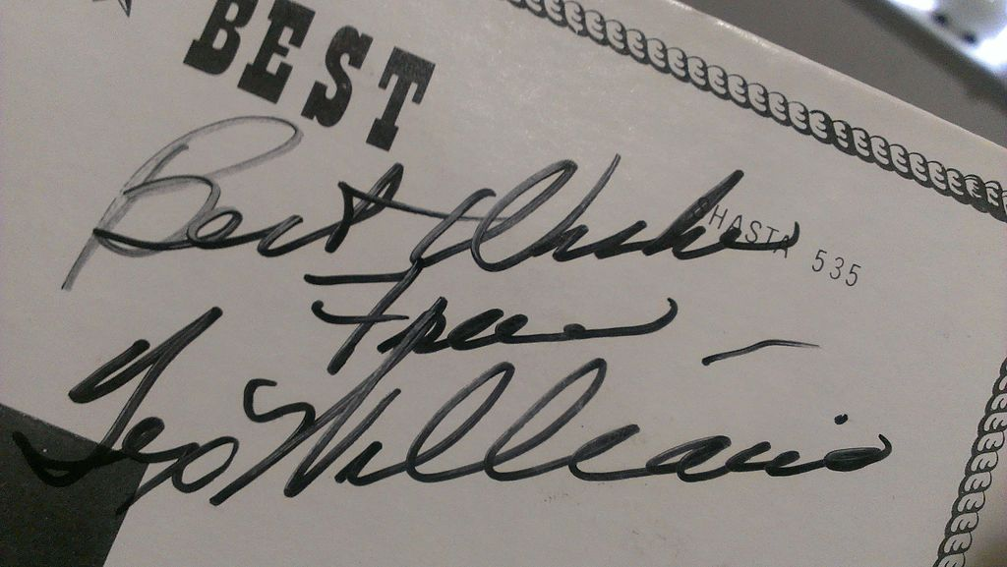
4
Handwriting recognition
Handwriting recognition (HWR) is the ability of a computer to receive and interpret intelligible handwritten input from sources such as paper documents, photographs, touch-screens and other devices. The image of the written text may be sensed "off line" from a piece of paper by optical scanning or intelligent word recognition. Alternatively, the movements of the pen tip may be sensed "on line", for example by a pen-based computer screen surface, a generally easier task as there are more clues available.

Slide 14
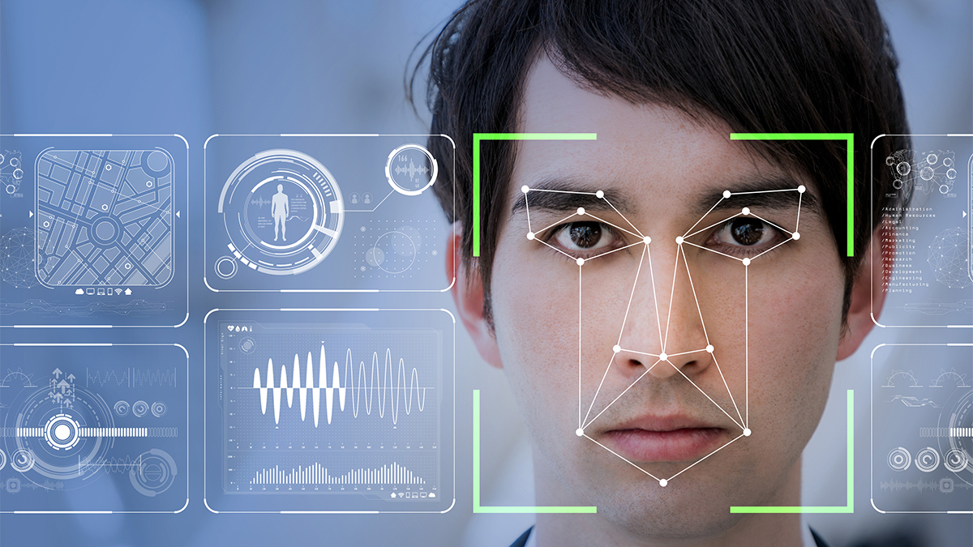
5
Image recognition
Deep learning-based image recognition has become "superhuman", producing more accurate results than human contestants.
Deep learning-trained vehicles now
interpret 360° camera views.
Facial recognition .

Slide 15

6
Recommendation systems

Slide 16

7
Mobile advertising
Finding the appropriate mobile audience for mobile advertising is always challenging, since many data points must be considered and assimilated before a target segment can be created and used in ad serving by any ad server. Deep learning has been used to interpret large, many-dimensioned advertising datasets. Many data points are collected during the request/serve/click internet advertising cycle. This information can form the basis of machine learning to improve ad selection.

Slide 17
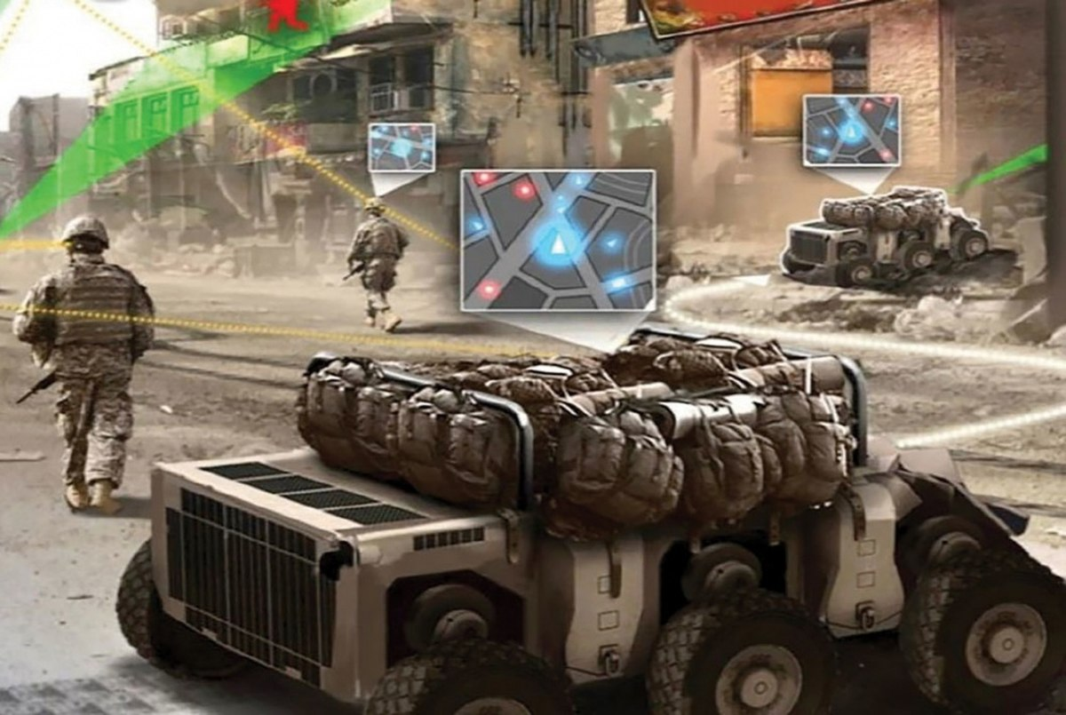
8
Military
The United States Department of Defense applied deep learning to train robots in new tasks through observation

Slide 18
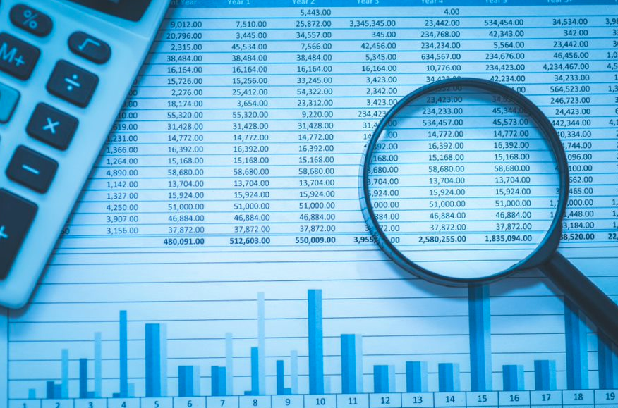
9
Financial fraud detection
Deep learning is being successfully applied to financial fraud detection and anti-money laundering

Slide 19
Neural Networks Problems

Slide 20
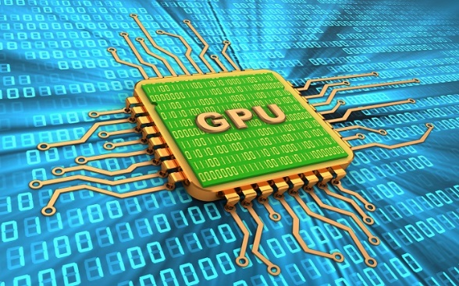
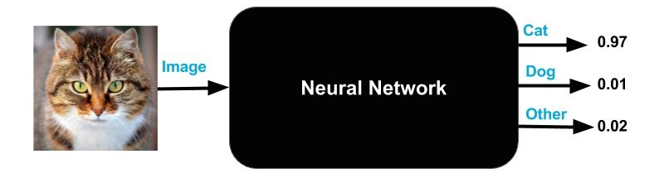
Neural Networks Problems
02
Compute hungry
01
Training time
04
Data hungry
Black box problem/ interpretability
03

Slide 21
Thank You

